Slide 1
SEC Timeline & Trivia
90th Anniversary

Slide 2
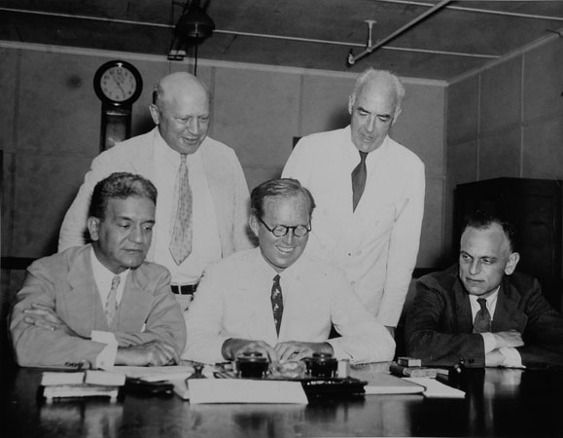
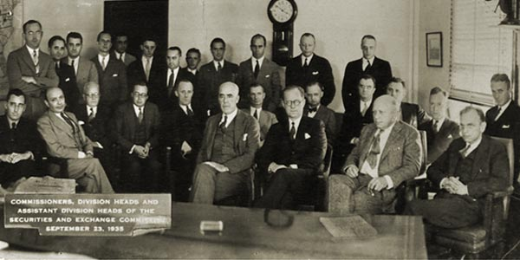
1930s
SEC Commission – July 2, 1934
SEC Commission with Senior Staff – Sept. 23,1935
George C. Mathews and Robert E. Healy, Ferdinand Pecora, Joseph P. Kennedy and James M. Landis
(Courtesy of the Washington Evening Star Collection, Washingtonian Division, D.C. Public Library, SEC Historical Society)
Paul Gourrich, Robert E. Healy, Joseph P. Kennedy, James M. Landis, George C. Mathews and Kemper Simpson
(Courtesy of SEC Historical Society, Library of Congress)
90th ANNIVERSARY

Slide 3
Which President appointed the first Chairman of the SEC, Joseph P. Kennedy?
A) Harry Truman
B) John Kennedy
C) Franklin Roosevelt
D) Ronald Reagan
90th ANNIVERSARY

Slide 4
Which President appointed the first Chairman of the SEC, Joseph P. Kennedy?
C) Franklin Roosevelt
Franklin Roosevelt appointed Joseph P. Kennedy as the first Chairman of the SEC shortly after signing the Securities Exchange Act into law.
90th ANNIVERSARY

Slide 5
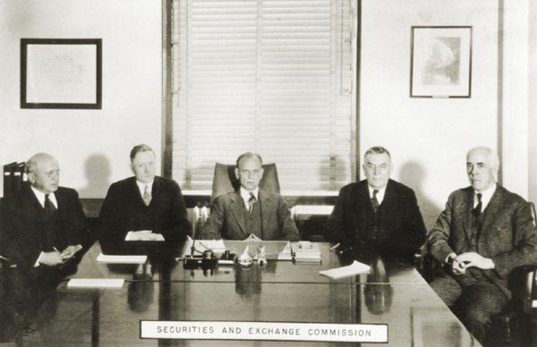
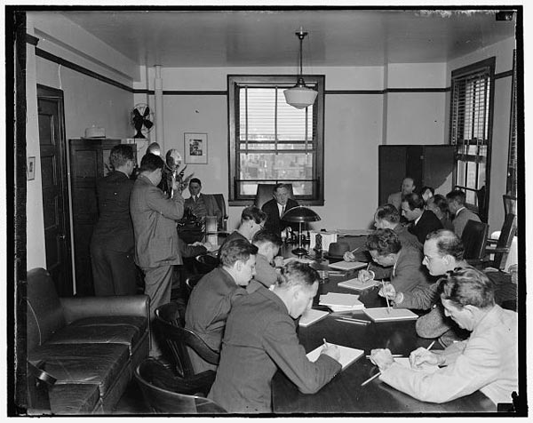
1930s
SEC Chairman William O. Douglas holds first press conference – Sept. 22, 1937
SEC Commission – 1936-1937
George C. Mathews, William O. Douglas, James M. Landis, J.D. Ross and Robert E. Healy
(Courtesy of SEC Historical Society)
(Courtesy of SEC Historical Society, Library of Congress)
90th ANNIVERSARY

Slide 6
Who among the following did NOT serve as an SEC Commissioner?
A) Joseph P. Kennedy
B) Kennesaw M. Landis
C) William O. Douglas
D) Edmund Burke Jr.
90th ANNIVERSARY

Slide 7
Who among the following did NOT serve as an SEC Commissioner?
B) Kennesaw M. Landis
Kennesaw Landis served as a federal judge and Commissioner of Major League Baseball, but never as an SEC Commissioner. A gentleman with the same surname, James M. Landis, served as an SEC Commissioner from 1934 to 1937.
90th ANNIVERSARY

Slide 8
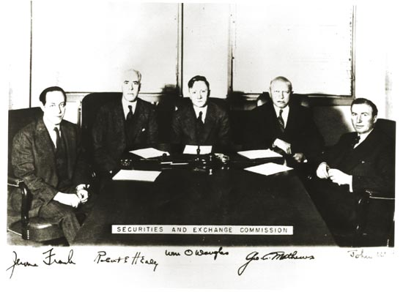
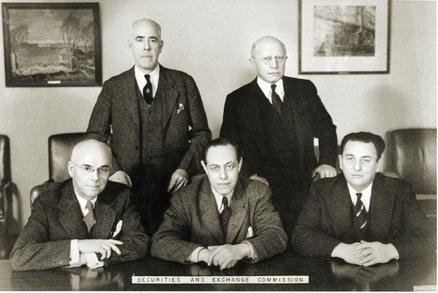
1930s
SEC Commission – 1938
SEC Commission – 1939-1940
Jerome Frank, Robert Healy, William O. Douglas, George Mathews and John Hanes
(Courtesy of SEC Historical Society)
Robert E. Healy and George C. Mathews, Edward C. Eicher, Jerome N. Frank and Leon Henderson
(Courtesy of SEC Historical Society)
90th ANNIVERSARY

Slide 9
The SEC suddenly lost one-third of its staff in 1942 for what reason?
A) Budget cuts
B) Unprecedented new opportunities arose in the defense bar
C) The agency moved to Philidelphia
D) None of the above
90th ANNIVERSARY

Slide 10
The SEC suddenly lost one-third of its staff in 1942 for what reason?
D) None of the above
The actual reason was that one-third of the staff left for military service in World War II.
90th ANNIVERSARY

Slide 11
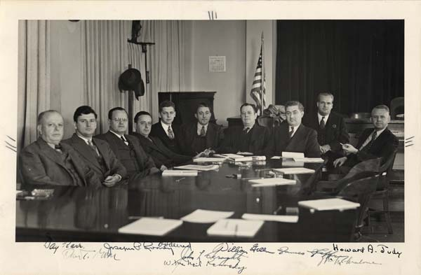
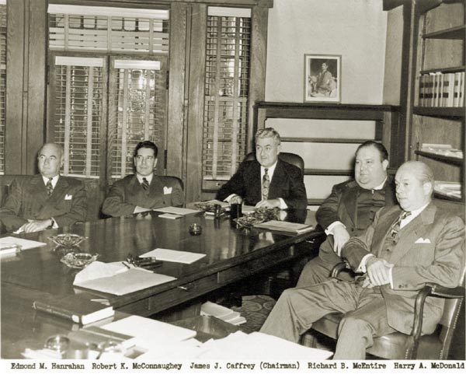
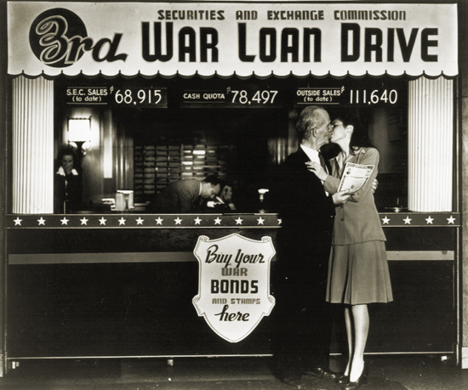
1940s
SEC Regional Administrators Meeting – 1941
SEC Commission – 1947
SEC War Loan D – e – 1943
Day Karr, Daniel T. Moore, Joseph P. Rooney, O.H. Allred, William McNeil Kennedy, John L. Geraghty, William E. Green, James J. Caffrey, William Malone and Howard A. Judy
(Courtesy of Frances Green Oliver, Courtesy of SEC Historical Society)
Edmond M. Hanrahan, Robert K. McConnaughey, James J. Caffrey, Richard B. McEntire and Harry A. McDonald
(Courtesy of SEC Historical Society)
(Courtesy of SEC Historical Society)
90th ANNIVERSARY

Slide 12
In which city has the SEC never had an office?
A) Seattle
B) Tulsa
C) St. Paul
D) Las Vegas
90th ANNIVERSARY

Slide 13
In which city has the SEC never had an office?
D) Las Vegas
The SEC had a regional office in Seattle that closed in 1994 and instituted several "branch offices" in the 1940s in such cities as Tulsa and St. Paul, but never ventured to Fremont Street or The Strip.
90th ANNIVERSARY

Slide 14
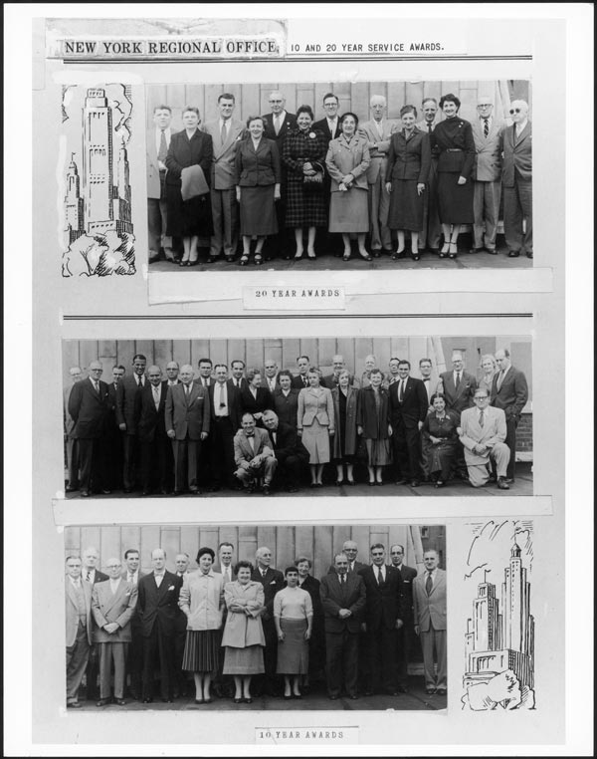
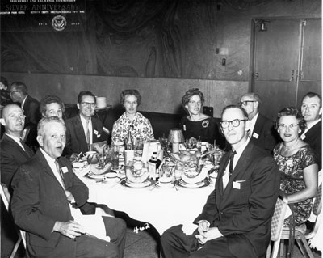
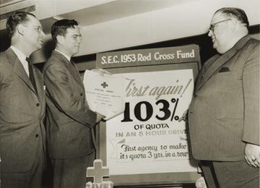
1950s
SEC New York Regional Office 10- and 20-Year Service Awards – 1955
SEC 25th Anniversary Dinner – Oct. 8, 1959
SEC Red Cross Fund Drive – 1953
SEC Chairman Donald C. Cook and SEC Commissioner Richard B. McEntire
(Courtesy of SEC Historical Society)
(Courtesy of SEC Historical Society)
(Courtesy of SEC Historical Society)
90th ANNIVERSARY

Slide 15
Who is the only SEC Chairman who also served on the U.S. Supreme Court?
A) William O. Douglas
B) Joseph P. Kennedy
C) James M. Landis
D) Christopher Cox
90th ANNIVERSARY

Slide 16
Which is the only SEC Chairman who also served on the U.S. Supreme Court?
A) William O. Douglas
While serving as the third Chairman of the SEC, William O. Douglas was appointed to the Supreme Court in April 1939.
90th ANNIVERSARY

Slide 17
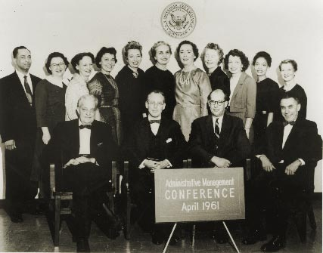
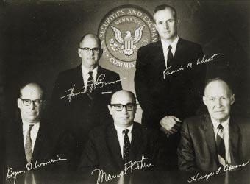
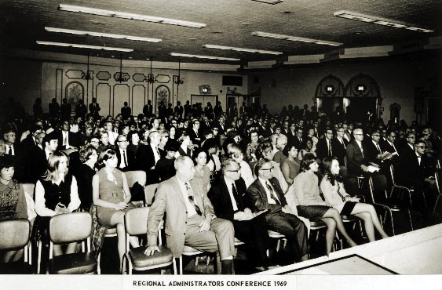
1960s
SEC Administrative Management Conference – April 1961
SEC Commission – Oct. 2, 1964​
SEC Regional Administrators Conference – 1969
Hamer Budge and Francis M. Wheat, Byron D. Woodside, Manuel Cohen and Hugh F. Owens
(Courtesy of SEC Historical Society)
(Courtesy of SEC Historical Society)
(Courtesy of SEC Historical Society​)
90th ANNIVERSARY

Slide 18
In what year during the Commission’s 90-year history did the Dow Jones Industrial Average break 1,000 points for the first time?
A) 1962
B) 1972
C) 1982
D) 1992
90th ANNIVERSARY

Slide 19
In what year during the Commission’s 90-year history did the Dow Jones Industrial Average break 1,000 points for the first time?
B) 1972
On Nov. 14, 1972, the Dow Jones Industrial Average closed above 1,000 for the first time.
90th ANNIVERSARY

Slide 20
The first female SEC Commissioner was appointed by which president?
A) Lincoln
B) Kennedy
C) Carter
D) Reagan
90th ANNIVERSARY

Slide 21
The first female SEC Commissioner was appointed by which president?
C) Carter
President Jimmy Carter appointed Roberta Karmel as the first female Commissioner at the SEC. She served in the New York Regional Office during the 1960s and as a public director of the New York Stock Exchange.
90th ANNIVERSARY

Slide 22
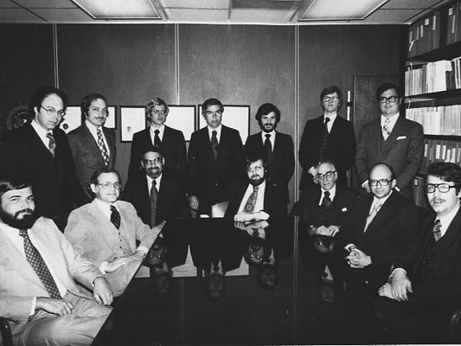
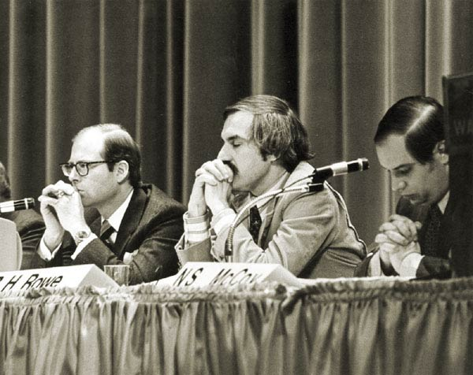
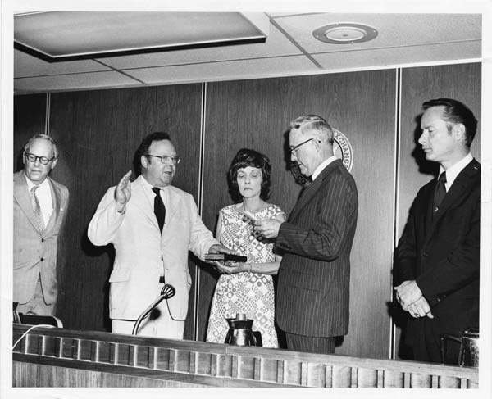
1970s
SEC General Counsel's Office – May 2, 1978
Swearing-in ceremony for SEC Chairman Ray Garrett, Jr. – Sept. 4, 1973
SEC Division of Corporation Finance Meeting – Early 1970s
David Ferber, Paul Gonson, Harvey Pitt, Robert Pozen, Alan Rosenblat, James Schropp, Jacob Stillman and Michael Wolensky
(Courtesy of SEC Historical Society)
Andrew Steffan, Chief Financial Analyst; Richard Rowe, Associate Director; Neal McCoy, Chief Counsel.
(Courtesy of Richard Rowe, SEC Historical Society)
Philip A. Loomis, Jr., Ray Garrett, Jr., Virginia Garrett, Hugh Owens and John R. Evans
(Photo and identification courtesy of Nancy Garrett Worcester, SEC Historical Society)
90th ANNIVERSARY

Slide 23
The Securities Acts Amendments enacted in 1975 were considered a “first step in regulatory modernization” ... This legislation did NOT do which of the following?
A) Formally unfixed Commission rates
B) Required the SEC to promote a national market system
C) Shortened SEC Commissioner terms from 10 years to 5 years
D) Established the Municipal Securities Rulemaking Board
90th ANNIVERSARY

Slide 24
The Securities Acts Amendments enacted in 1975 were considered a “first step in regulatory modernization” ... This legislation did NOT do which of the following?
C) Shortened SEC Commissioner terms from 10 years to 5 years
The new law did not affect the length of Commissioner terms, which have remained the same since the Securities Exchange Act of 1934 established: "Each Commissioner shall hold office for a term of five years and until his successor is appointed..."
90th ANNIVERSARY

Slide 25
Who is the longest-serving Chairman in SEC history?
A) John Shad
B) Manuel Cohen
C) Hamer Budge
D) Arthur Levitt
90th ANNIVERSARY

Slide 26
Who is the longest-serving Chairman in SEC history?
D) Arthur Levitt
Arthur Levitt is the only Chairman in SEC history to have served in the role for more than seven years, beginning his tenure in July 1993 and concluding in February 2001.
90th ANNIVERSARY

Slide 27
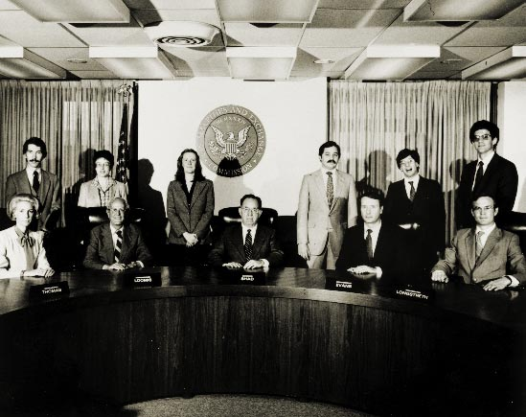
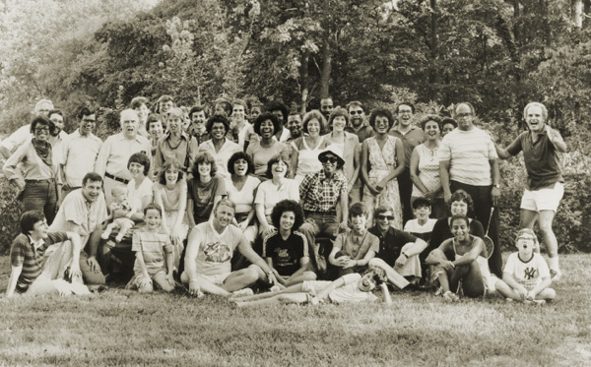
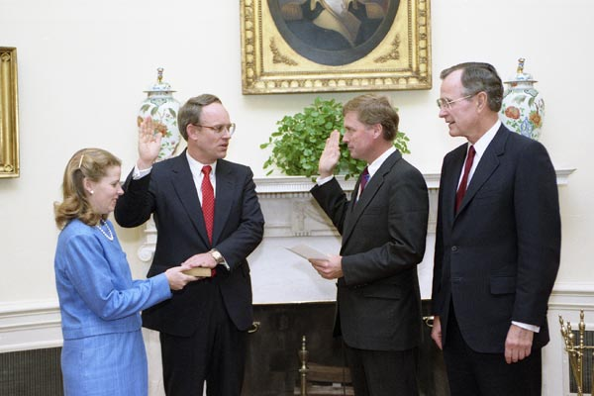
1980s
SEC Commission – January 1981
Swearing-in ceremony for SEC Chairman Richard Breeden in the White House – Oct. 11, 1989
SEC Staff Picnic – 1981
(Courtesy of Charles Leber, SEC Historical Society)
Stephen J. Friedman, Philip A. Loomis, Jr. Harold M. Williams, John R. Evans and Barbara S. Thomas
(Courtesy of SEC Historical Society)
Vice President Dan Quayle and President George H.W. Bush
(Courtesy of George Bush Presidential Library and Museum, SEC Historical Society)
90th ANNIVERSARY

Slide 28
How many women have served as SEC Commissioners?
A) 7
B) 10
C) 12
D) 14
90th ANNIVERSARY

Slide 29
How many women have served as SEC Commissioners?
D) 14
A total of 14 women have served as SEC Commissioners in its 90-year history, beginning with Roberta Karmel’s appointment in 1977.
90th ANNIVERSARY

Slide 30
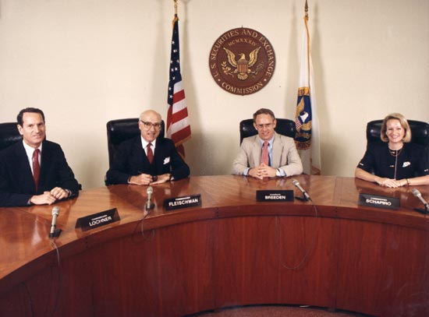
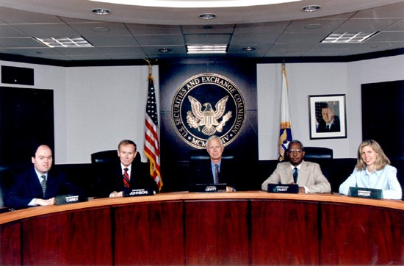
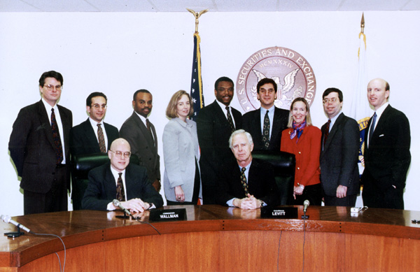
1990s
SEC Commission – 1990
SEC Commission – 1999
SEC Commission with Senior Staff – 1996
Paul R. Carey, Norman S. Johnson, Arthur Levitt, Isaac C. Hunt, Jr. and Laura S. Unger
(Courtesy of SEC Historical Society)
Philip R. Lochner, Jr., Edward H. Fleischman, Richard C. Breeden and Mary L. Schapiro
(Courtesy of SEC Historical Society)
(Courtesy of SEC Historical Society)​
90th ANNIVERSARY

Slide 31
Who is the longest-serving Commissioner in SEC history?
A) Arthur Levitt
B) Robert Healy
C) Philip Loomis
D) John Evans
90th ANNIVERSARY

Slide 32
Who is the longest-serving Commissioner in SEC history?
B) Robert Healy
No SEC Commissioner has served longer than Robert Healy, who was one of the inaugural Commission members appointed in July 1934. His tenure didn’t conclude until more than a dozen years later in November 1946.
90th ANNIVERSARY

Slide 33
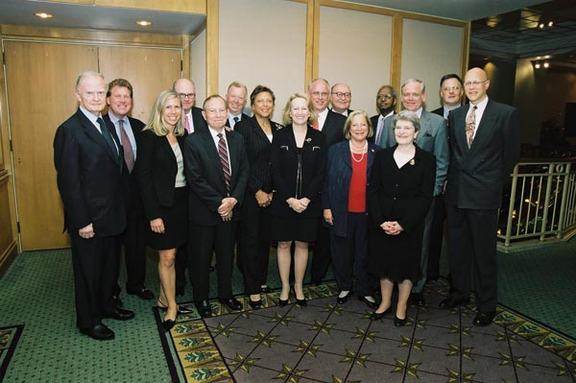
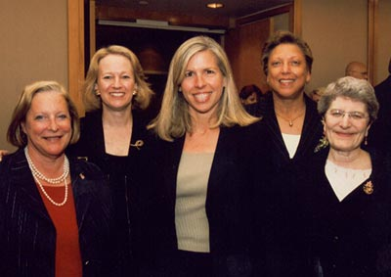
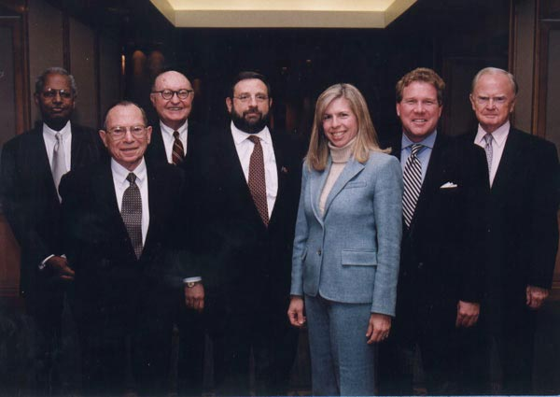
2000s
SEC 70th Anniversary Dinner – June 2, 2004
SEC Women Commissioners – June 2, 2004
SEC Chairmen and Commissioners Meeting – November 2002
Roderick Hills, J. Carter Beese, Laura Unger, G. Bradford Cook, Irving Pollack, Harvey Goldschmid, Aulana Peters, Mary Schapiro, Richard Breeden, David Ruder, Cynthia Glassman, Isaac Hunt, William Donaldson, Roberta Karmel, Richard Roberts and Steven Wallman
(Courtesy of SEC Historical Society)
Cynthia Glassman, Mary Schapiro, Laura Unger, Aulana Peters and Roberta Karmel
(Courtesy of SEC Historical Society)
Isaac C. Hunt, Jr., Irving M. Pollack, David S. Ruder, Harvey L. Pitt, Laura S. Unger, J. Carter Beese and Roderick M. Hills
(Courtesy of SEC Historical Society)
90th ANNIVERSARY

Slide 34
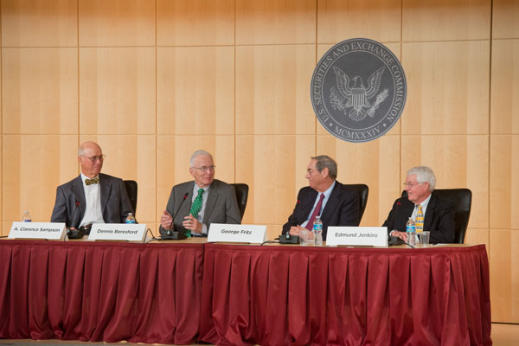
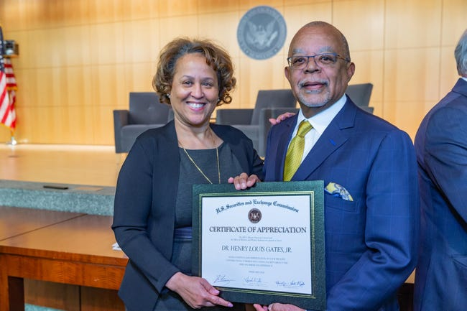
2010s
A Creative Irritant: The Relationship between the SEC and Accounting Standard Setters – June 7, 2012
Certificate of Appreciation – Feb. 27, 2019
A. Clarence Sampson, Dennis Beresford, George Fritz and Edmund Jenkins
(Courtesy of SEC Historical Society)
(Courtesy of OPA)​
90th ANNIVERSARY

Slide 35
Not long after the SEC’s 75th Anniversary, the SEC established a whistleblower program. What is the largest award ever issued to a whistleblower through that program?
A) Approximately $51 million
B) Approximately $96 million
C) Approximately $114 million
D) Approximately $279 million
90th ANNIVERSARY

Slide 36
Not long after the SEC’s 75th Anniversary, the SEC established a whistleblower program. What is the largest award ever issued to a whistleblower through that program?
D) Approximately $279 million
The largest whistleblower award ever issued by the SEC totaled approximately $279 million.
90th ANNIVERSARY

Slide 37
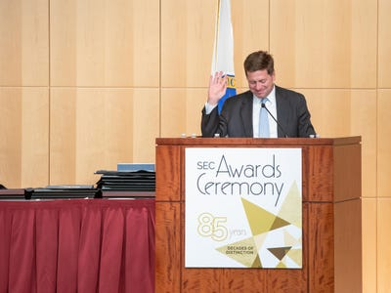
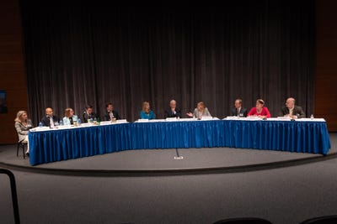
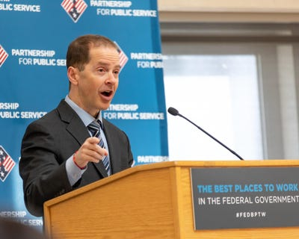
2010s
64th Awards Show – June 18, 2019
SEC's annual Government-Business Forum on Small Business Capital Formation, held in Omaha, Nebraska – Aug. 14, 2019
Best Workplace Award – Dec. 12, 2018
(Courtesy of OPA)
(Courtesy of OPA)
(Courtesy of OPA)
90th ANNIVERSARY

Slide 38
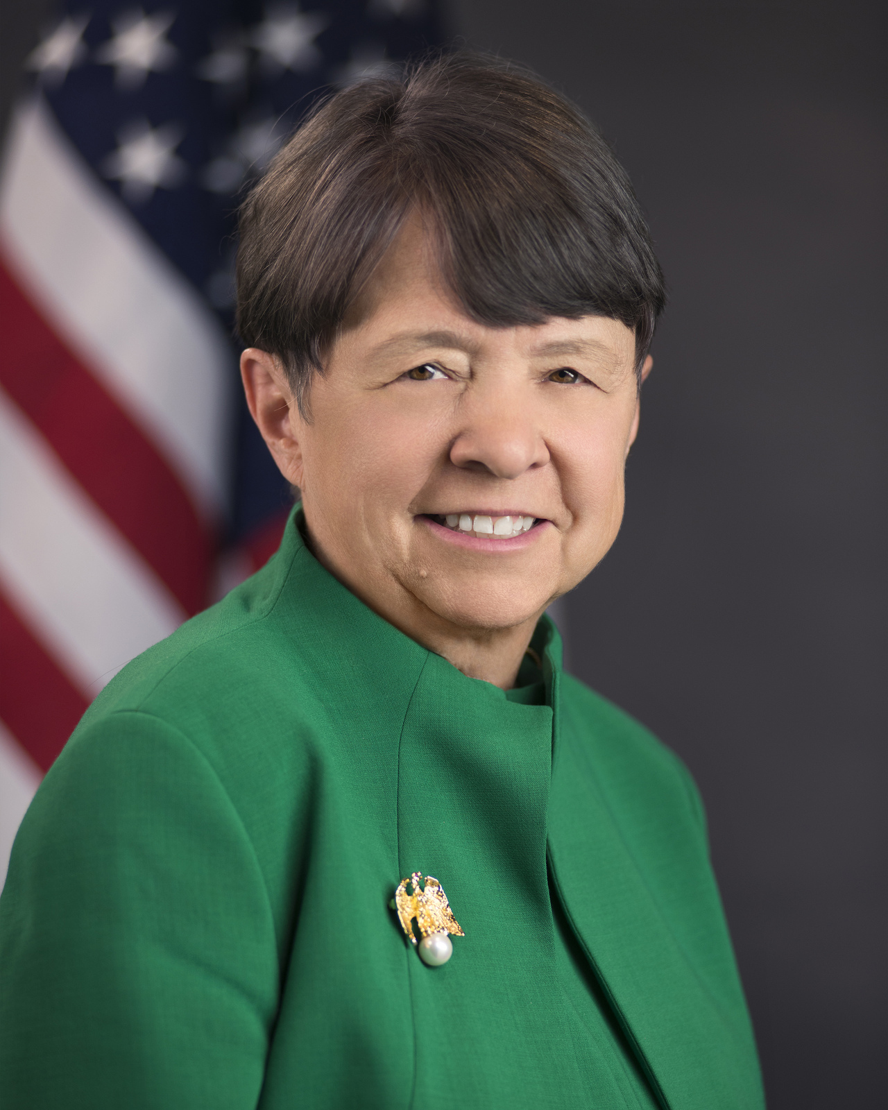
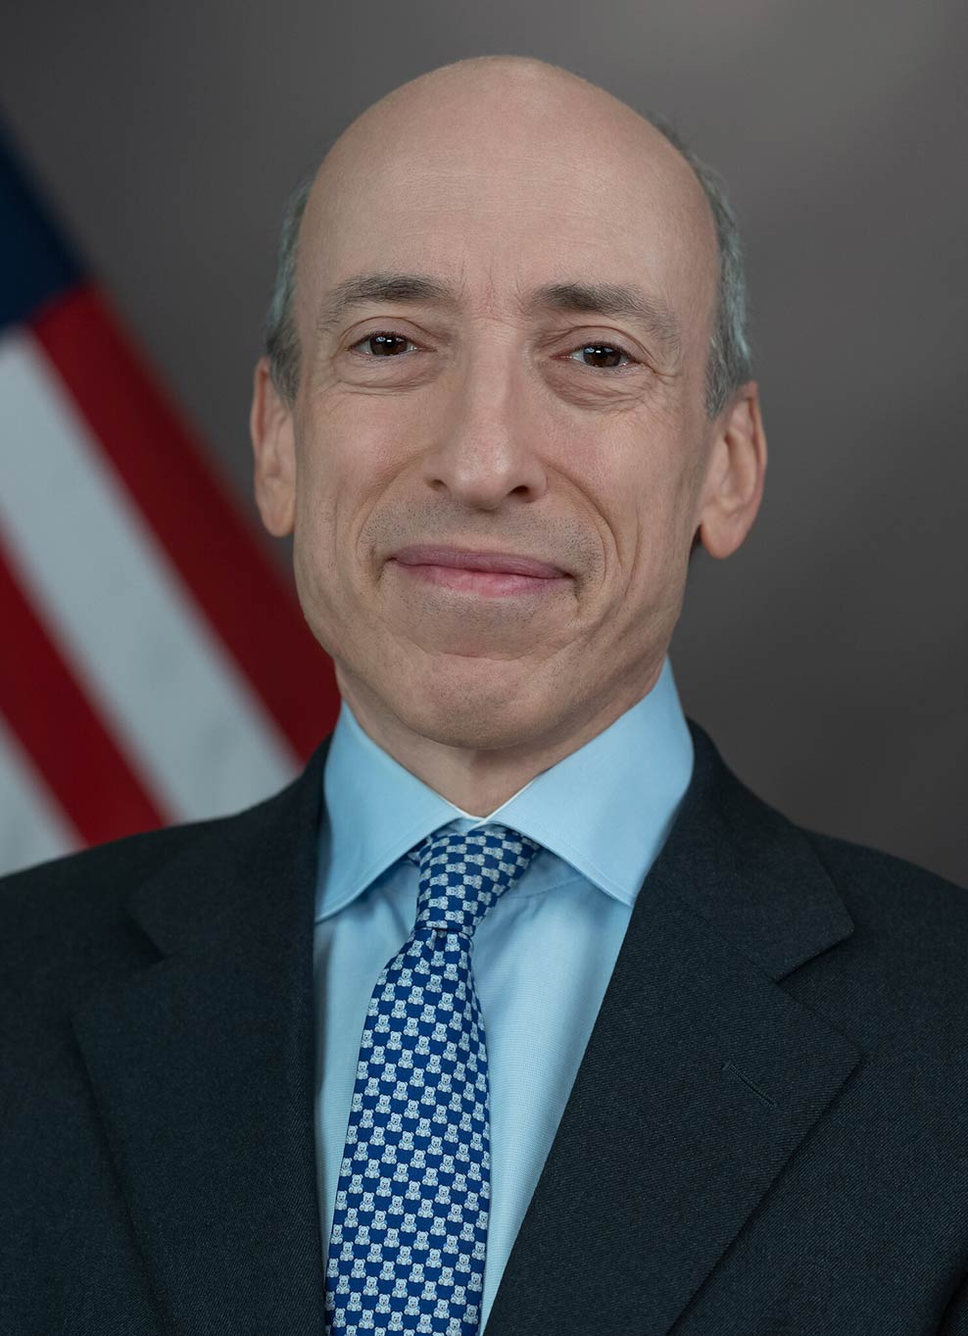
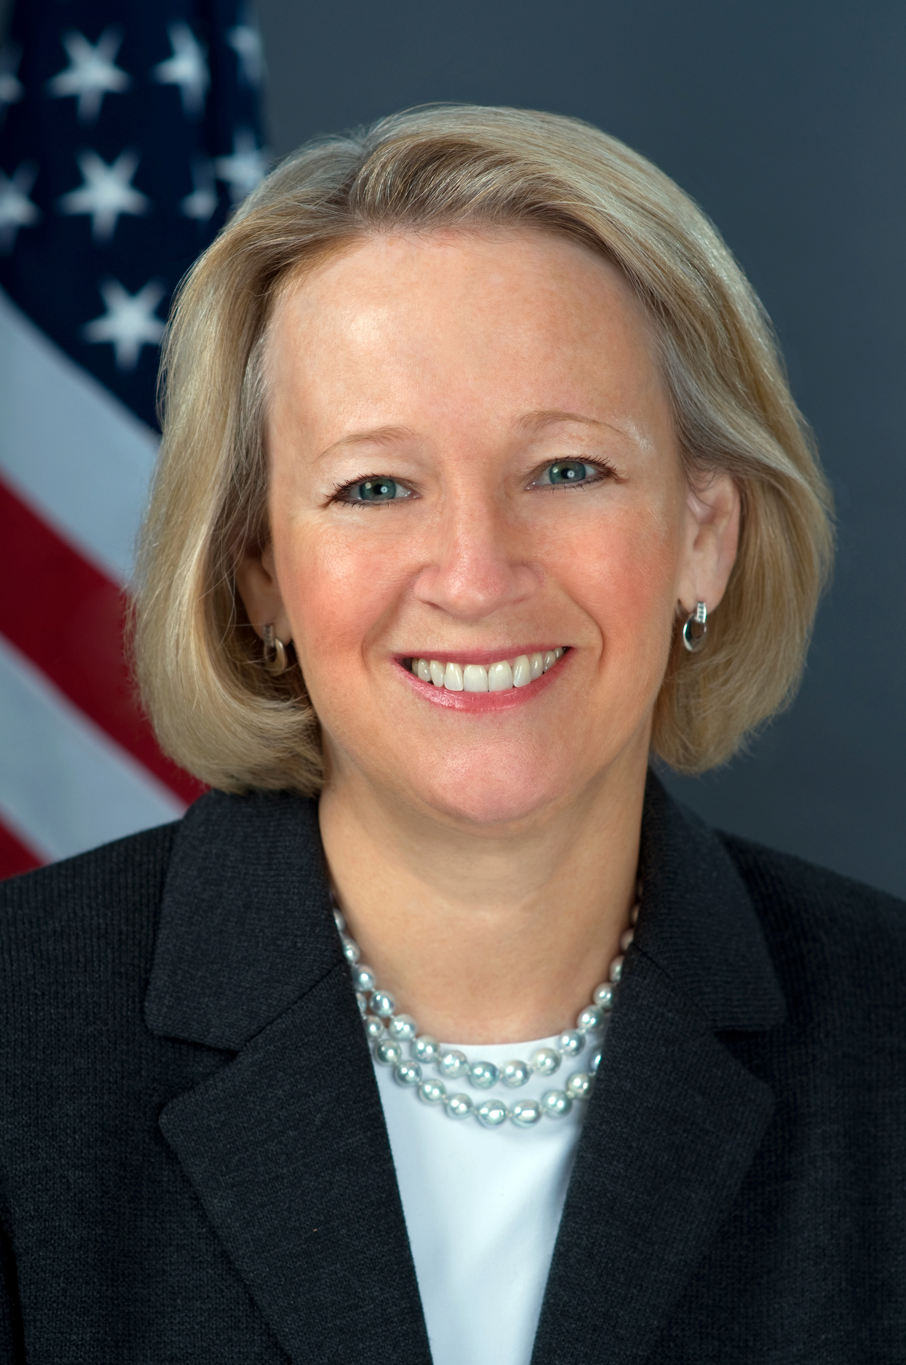
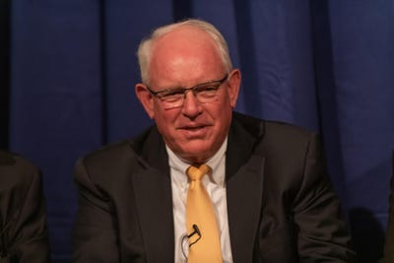
And now some trivia specific to the panelists and moderator of today's first panel discussion: A Lookback From the Chair’s Seat ...
Mary Jo White, SEC Chair – 2013-2017
Gary Gensler, SEC
Chair – 2021-present
Mary L. Schapiro, SEC Chair – 2009-2012
Richard Breeden, SEC
Chair – 1989-1993
90th ANNIVERSARY
(Courtesy of OPA)

Slide 39
Under which SEC Chair did the Commission implement changes to the operation of money market funds following the collapse of the Reserve Fund?
A) Richard Breeden
B) Mary Schapiro
C) Mary Jo White
D) Gary Gensler
90th ANNIVERSARY

Slide 40
Under which SEC Chair did the Commission implement changes to the operation of money market funds following the collapse of the Reserve Fund?
B) Mary Schapiro
Under Mary Schapiro, the Commission adopted final rules for money market funds that included improved liquidity and greater transparency.
90th ANNIVERSARY

Slide 41
Under which SEC Chair did the Commission adopt rules to enhance and standardize climate-related disclosures for investors?
A) Richard Breeden
B) Mary Schapiro
C) Mary Jo White
D) Gary Gensler
90th ANNIVERSARY

Slide 42
Under which SEC Chair did the Commission adopt rules to enhance and standardize climate-related disclosures for investors?
D) Gary Gensler
Chair Gensler led the Commission’s adoption of final rules to build on past requirements by mandating material climate risk disclosures by public companies and in public offerings.
90th ANNIVERSARY

Slide 43
Which SEC Chair was called a "real strong protector of shareholder rights" by a fellow Commissioner reflecting on a period when the Commission revised proxy policies for the first time in many years?
A) Richard Breeden
B) Mary Schapiro
C) Mary Jo White
D) Gary Gensler
90th ANNIVERSARY

Slide 44
Which SEC Chair was called a "real strong protector of shareholder rights" by a fellow Commissioner reflecting on a period when the Commission revised proxy policies for the first time in many years?
A) Richard Breeden
Richard Breeden led the Commission in the early 1990s when it adopted rules to enhance investor rights in corporate governance and substantially increase the amount of information available to shareholders.
90th ANNIVERSARY

Slide 45
Under which Chair was Regulation SCI adopted to strengthen the technology infrastructure of the securities markets?
A) Richard Breeden
B) Mary Schapiro
C) Mary Jo White
D) Gary Gensler
90th ANNIVERSARY

Slide 46
Under which Chair was Regulation SCI adopted to strengthen the technology infrastructure of the securities markets?
C) Mary Jo White
Regulation SCI was adopted under SEC Chair Mary Jo White to better protect investors by requiring comprehensive new controls for the technological systems of key market participants.
90th ANNIVERSARY

Slide 47
The Office of International Affairs, previously part of the Enforcement Division, became a separate office under which SEC Chair?
A) Richard Breeden
B) Mary Schapiro
C) Mary Jo White
D) Gary Gensler
90th ANNIVERSARY

Slide 48
The Office of International Affairs, previously part of the Enforcement Division, became a separate office under which SEC Chair?
A) Richard Breeden
The Office of International Affairs became a separate office under Richard Breeden when the collapse of the Soviet Union spurred more economic freedom globally and former communist countries began asking for help from the SEC in developing their own systems of market capitalism.
90th ANNIVERSARY

Slide 49
The SEC's Office of the Investor Advocate began operations under which SEC Chair?
A) Richard Breeden
B) Mary Schapiro
C) Mary Jo White
D) Gary Gensler
90th ANNIVERSARY

Slide 50
The SEC's Office of the Investor Advocate began operations under which SEC Chair?
C) Mary Jo White
The Office of the Investor Advocate, established under the Dodd-Frank Act, began operating in February 2014 while Mary Jo White was the SEC Chair.
90th ANNIVERSARY

Slide 51
The Division of Economic and Risk Analysis (DERA) was created under which SEC Chair?
A) Richard Breeden
B) Mary Schapiro
C) Mary Jo White
D) Gary Gensler
90th ANNIVERSARY

Slide 52
The Division of Economic and Risk Analysis (DERA) was created under which SEC Chair?
B) Mary Schapiro
DERA was created in 2009 under Mary Schapiro to further integrate financial economics and rigorous data analytics into the core mission of the SEC.
90th ANNIVERSARY

Slide 53
Which SEC Chair renamed and expanded the Enforcement Division’s unit dedicated to protecting investors from cyber-related threats?
A) Richard Breeden
B) Mary Schapiro
C) Mary Jo White
D) Gary Gensler
90th ANNIVERSARY

Slide 54
Which SEC Chair renamed and expanded the Enforcement Division’s unit dedicated to protecting investors from cyber-related threats?
D) Gary Gensler
Chair Gensler announced in May 2022 that the newly renamed Crypto Assets and Cyber Unit was nearly doubling in size to better equip the SEC to police wrongdoing in the crypto markets while continuing to identify disclosure and controls issues with respect to cybersecurity.
90th ANNIVERSARY

Slide 55
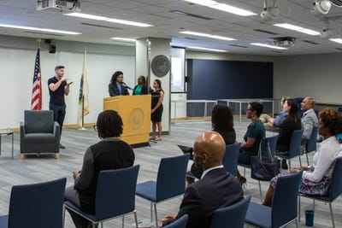
2020s
Open Commission Meeting – Sept. 20, 2023
Caribbean American Heritage Month Event – June 29, 2023
(Courtesy of OPA)​
(Courtesy of OPA)​​
90th ANNIVERSARY

Slide 56
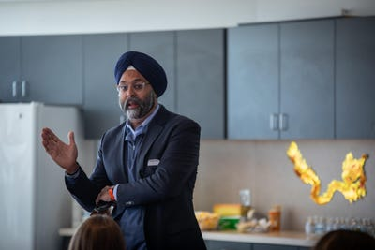
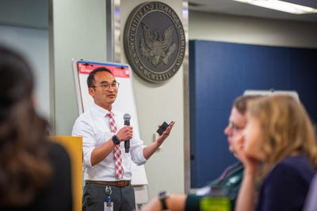
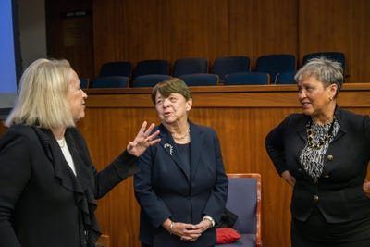
2020s
Lunar New Year Luncheon – Feb. 21, 2024
Corporation Finance Leadership Conference – April 25, 2024
Howard University School of Law, OMWI Conversation – March 1, 2023
(Courtesy of OPA)​​
(Courtesy of OPA)​​
(Courtesy of OPA)​​
90th ANNIVERSARY

Slide 57
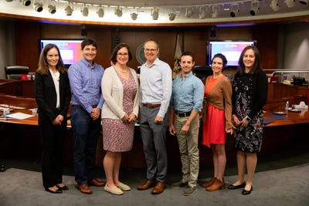
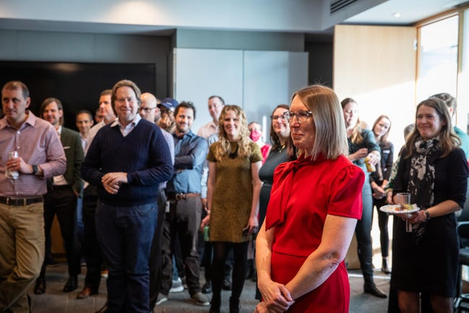
2020s
Office of the General Counsel Town Hall Awards – May 9, 2024
SEC Holiday Party – Dec. 8, 2023
(Courtesy of OPA)​​​
(Courtesy of OPA)​​​​
90th ANNIVERSARY

Slide 58
Thank you for coming!
SEC 90th Anniversary

